Slide 1

IS2020 COMP 8157: Advanced Database Topics Lecture 03: SQL, PL/SQL
Dr. Kalyani Selvarajah
kalyanis@uwindsor.ca
School of Computer Science
University of Windsor
Windsor, Ontario, Canada
May 21, 2020

Slide 2
Objectives of SQL
Ideally, database language should allow user to:
create the database and relation structures;
perform insertion, modification, deletion of data from relations;
perform simple and complex queries.
Must perform these tasks with minimal user effort and command structure/syntax must be easy to learn.
It must be portable.
SQL is a transform-oriented language with 2 major components:
A DDL for defining database structure.
A DML for retrieving and updating data.
Until SQL:1999, SQL did not contain flow of control commands. These had to be implemented using a programming or job-control language, or interactively by the decisions of user.
SQL is relatively easy to learn:
it is non-procedural - you specify what information you require, rather than how to get it;
it is essentially free-format.

Slide 3
Objectives of SQL
Consists of standard English words:
1) CREATE TABLE Staff(staffNo VARCHAR(5),
lName VARCHAR(15),
salary DECIMAL(7,2));
2) INSERT INTO Staff VALUES (‘SG16’, ‘Brown’, 8300);
3) SELECT staffNo, lName, salary
FROM Staff
WHERE salary > 10000;

Slide 4
Objectives of SQL
Can be used by range of users including DBAs, management, application developers, and other types of end users.
An ISO standard now exists for SQL, making it both the formal and de facto standard language for relational databases.

Slide 5
History of SQL
In 1974, D. Chamberlin (IBM San Jose Laboratory) defined language called ‘Structured English Query Language’ (SEQUEL).
A revised version, SEQUEL/2, was defined in 1976 but name was subsequently changed to SQL for legal reasons.
Still pronounced ‘see-quel’, though official pronunciation is ‘S-Q-L’.
IBM subsequently produced a prototype DBMS called System R, based on SEQUEL/2.
Roots of SQL, however, are in SQUARE (Specifying Queries as Relational Expressions), which predates System R project.

Slide 6
History of SQL
In late 70s, ORACLE appeared and was probably first commercial RDBMS based on SQL.
In 1987, ANSI and ISO published an initial standard for SQL.
In 1989, ISO published an addendum that defined an ‘Integrity Enhancement Feature’.
In 1992, first major revision to ISO standard occurred, referred to as SQL2 or SQL/92.
In 1999, SQL:1999 was released with support for object-oriented data management.
In late 2003, SQL:2003 was released.
In summer 2008, SQL:2008 was released.
In late 2011, SQL:2011 was released.

Slide 7
Importance of SQL
SQL has become part of application architectures such as IBM’s Systems Application Architecture.
It is strategic choice of many large and influential organizations (e.g. X/OPEN).
SQL is Federal Information Processing Standard (FIPS) to which conformance is required for all sales of databases to American Government.
SQL is used in other standards and even influences development of other standards as a definitional tool. Examples include:
ISO’s Information Resource Directory System (IRDS) Standard
Remote Data Access (RDA) Standard.

Slide 8
Writing SQL Commands
SQL statement consists of reserved words and user-defined words.
Reserved words are a fixed part of SQL and must be spelt exactly as required and cannot be split across lines.
User-defined words are made up by user and represent names of various database objects such as relations, columns, views.
Most components of an SQL statement are case insensitive, except for literal character data.
More readable with indentation and lineation:
Each clause should begin on a new line.
Start of a clause should line up with start of other clauses.
If clause has several parts, should each appear on a separate line and be indented under start of clause.

Slide 9
Writing SQL Commands
Use extended form of BNF notation:
Upper-case letters represent reserved words.
Lower-case letters represent user-defined words.
| indicates a choice among alternatives.
Curly braces indicate a required element.
Square brackets indicate an optional element.
… indicates optional repetition (0 or more).

Slide 10
Literals
Literals are constants used in SQL statements.
All non-numeric literals must be enclosed in single quotes (e.g. ‘London’).
All numeric literals must not be enclosed in quotes (e.g. 650.00).

Slide 11
SELECT Statement
SELECT [DISTINCT | ALL]
{* | [columnExpression [AS newName]] [,...] }
FROM TableName [alias] [, ...]
[WHERE condition]
[GROUP BY columnList] [HAVING condition]
[ORDER BY columnList]

Slide 12
SELECT Statement
FROM Specifies table(s) to be used.
WHERE Filters rows.
GROUP BY Forms groups of rows with same
column value.
HAVING Filters groups subject to some
condition.
SELECT Specifies which columns are to
appear in output.
ORDER BY Specifies the order of the output.

Slide 13
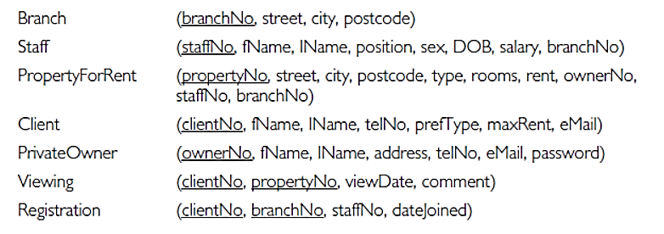
Relational Database Schemas
The relational schema for part of the DreamHome case study is:

Slide 14
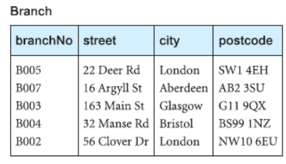
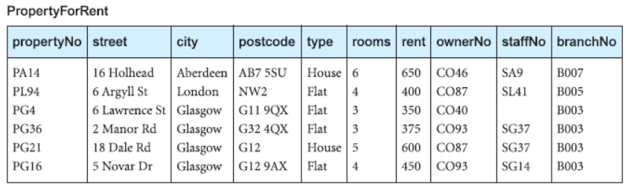
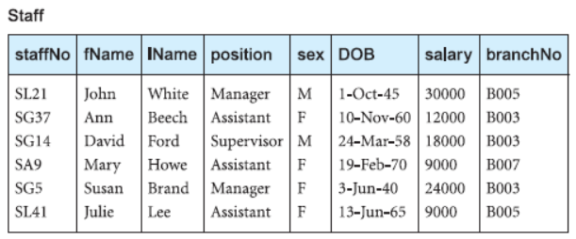
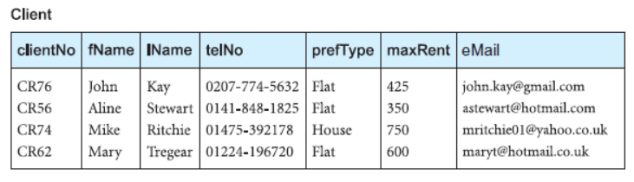
Instance of relational schema

Slide 15
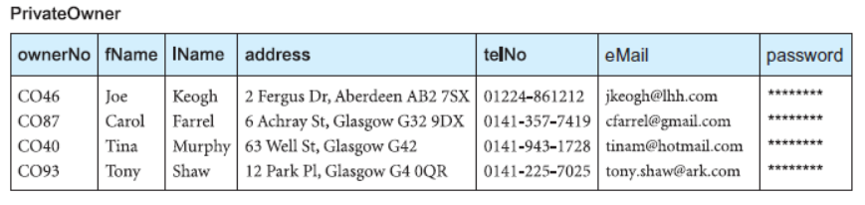
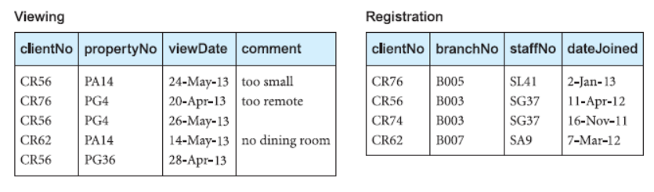
Instance of relational schema

Slide 16
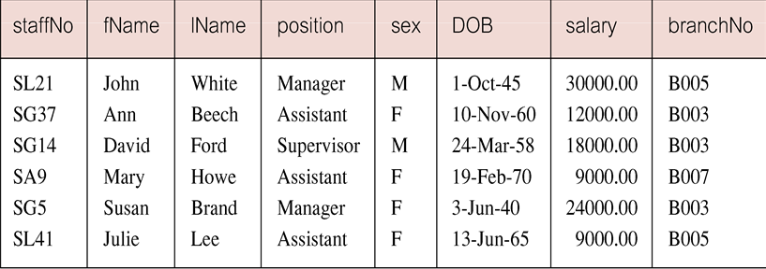
SELECT Statement
Order of the clauses cannot be changed.
Only SELECT and FROM are mandatory.
Example: All Columns, All Rows
List full details of all staff.
SELECT staffNo, fName, lName, address,
position, sex, DOB, salary, branchNo
FROM Staff;
Can use * as an abbreviation for ‘all columns’:
SELECT *
FROM Staff;

Slide 17
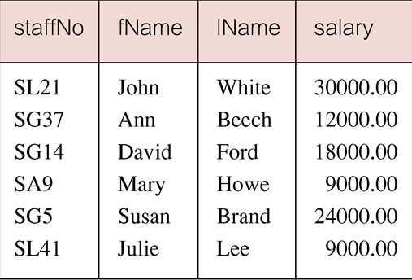
SELECT Statement: Specific Columns, All Rows
Example: Specific Columns, All Rows
Produce a list of salaries for all staff, showing only staff number, first and last names, and salary.
SELECT staffNo, fName, lName, salary
FROM Staff;

Slide 18
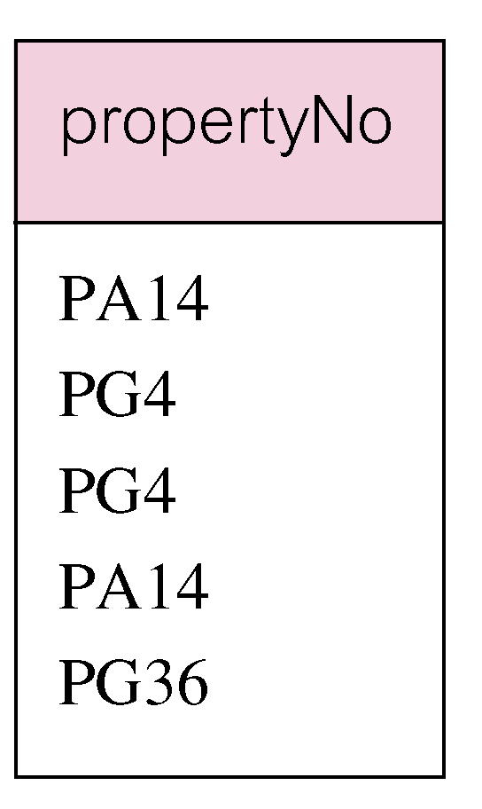
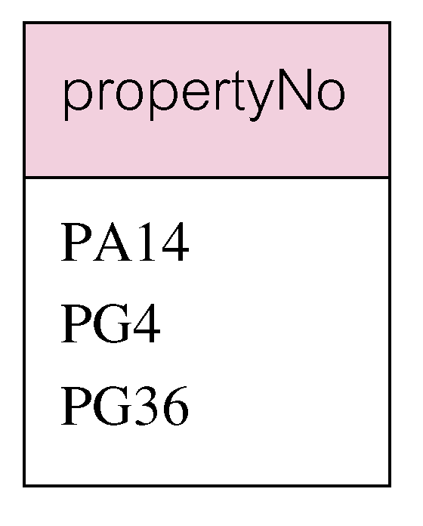
SELECT Statement: DISTINCT
Example 6.3 Use of DISTINCT
List the property numbers of all properties that have been viewed.
SELECT propertyNo
FROM Viewing;
Use DISTINCT to eliminate duplicates
SELECT DISTINCT propertyNo
FROM Viewing;

Slide 19
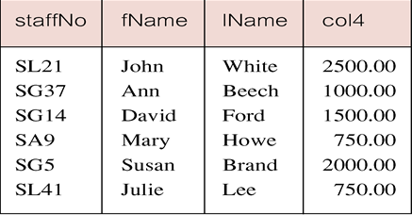
SELECT Statement: Calculated Fields
Example: Calculated Fields
Produce list of monthly salaries for all staff, showing staff number, first/last name, and salary.
SELECT staffNo, fName, lName, salary/12
FROM Staff;
To name column, use AS clause:
SELECT staffNo, fName, lName, salary/12 AS monthlySalary
FROM Staff;

Slide 20
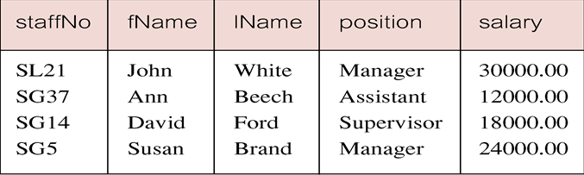
SELECT Statement: Comparison Search Condition
Example: Comparison Search Condition
List all staff with a salary greater than 10,000.
SELECT staffNo, fName, lName, position, salary
FROM Staff
WHERE salary > 10000;

Slide 21
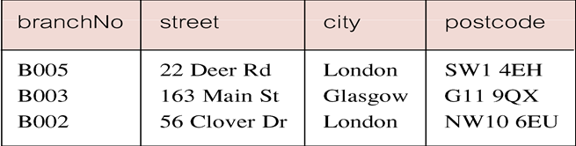
SELECT Statement: Compound Comparison Search Condition
Example: Compound Comparison Search Condition
List addresses of all branch offices in London or Glasgow.
SELECT *
FROM Branch
WHERE city = ‘London’ OR city = ‘Glasgow’;

Slide 22
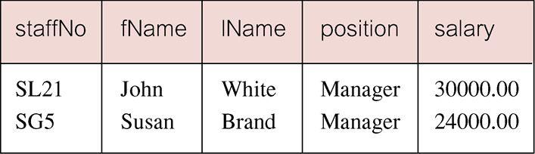
SELECT Statement: Range Search Condition
Example: Range Search Condition
List all staff with a salary between 20,000 and 30,000.
SELECT staffNo, fName, lName, position, salary
FROM Staff
WHERE salary BETWEEN 20000 AND 30000;
BETWEEN test includes the endpoints of range.

Slide 23
SELECT Statement: Range Search Condition
Example: Range Search Condition
Also a negated version NOT BETWEEN.
BETWEEN does not add much to SQL’s expressive power. Could also write:
SELECT staffNo, fName, lName, position, salary
FROM Staff
WHERE salary>=20000 AND salary <= 30000;
Useful, though, for a range of values.

Slide 24
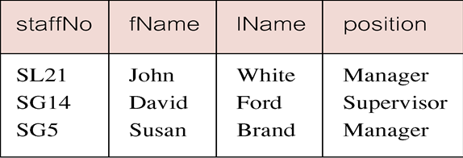
SELECT Statement: Set Membership
Example: Set Membership
List all managers and supervisors.
SELECT staffNo, fName, lName, position
FROM Staff
WHERE position IN (‘Manager’, ‘Supervisor’);
There is a negated version (NOT IN).
IN does not add much to SQL’s expressive power. Could have expressed this as:
SELECT staffNo, fName, lName, position
FROM Staff
WHERE position=‘Manager’ OR position=‘Supervisor’;
IN is more efficient when set contains many values.

Slide 25
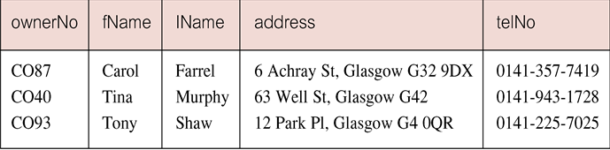
SELECT Statement: Pattern Matching
Example: Pattern Matching
Find all owners with the string ‘Glasgow’ in their address.
SELECT ownerNo, fName, lName, address, telNo
FROM PrivateOwner
WHERE address LIKE ‘%Glasgow%’;
SQL has two special pattern matching symbols:
%: sequence of zero or more characters;
_ (underscore): any single character.
LIKE ‘%Glasgow%’ means a sequence of characters of any length containing ‘Glasgow’.

Slide 26
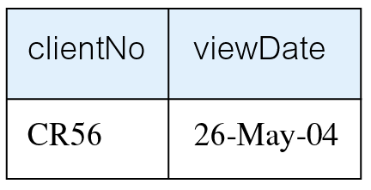
SELECT Statement: NULL Search Condition
Example: NULL Search Condition
List details of all viewings on property PG4 where a comment has not been supplied.
There are 2 viewings for property PG4, one with and one without a comment.
Have to test for null explicitly using special keyword IS NULL:
SELECT clientNo, viewDate
FROM Viewing
WHERE propertyNo = ‘PG4’ AND comment IS NULL;
Negated version (IS NOT NULL) can test for non-null values.

Slide 27
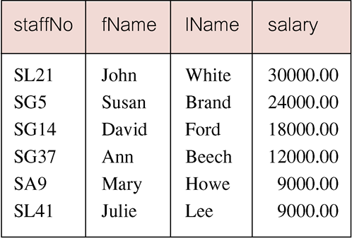
SELECT Statement: Single Column Ordering
Example: Single Column Ordering
List salaries for all staff, arranged in descending order of salary.
SELECT staffNo, fName, lName, salary
FROM Staff
ORDER BY salary DESC;

Slide 28
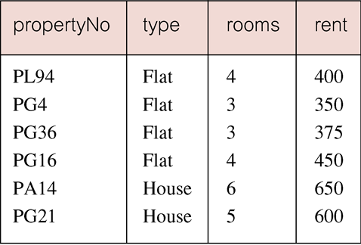
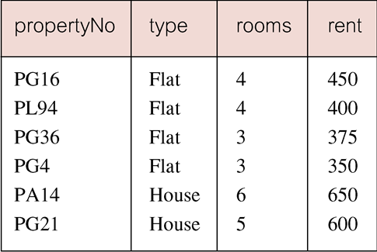
SELECT Statement: Example 6.12 Multiple Column Ordering
Example: Multiple Column Ordering
Produce abbreviated list of properties in order of property type.
SELECT propertyNo, type, rooms, rent
FROM PropertyForRent
ORDER BY type;
Four flats in this list - as no minor sort key specified, system arranges these rows in any order it chooses.
To arrange in order of rent, specify minor order:
SELECT propertyNo, type, rooms, rent
FROM PropertyForRent
ORDER BY type, rent DESC;

Slide 29
SELECT Statement - Aggregates
ISO standard defines five aggregate functions:
COUNT returns number of values in specified column.
SUM returns sum of values in specified column.
AVG returns average of values in specified column.
MIN returns smallest value in specified column.
MAX returns largest value in specified column.

Slide 30
SELECT Statement - Aggregates
Each operates on a single column of a table and returns a single value.
COUNT, MIN, and MAX apply to numeric and non-numeric fields, but SUM and AVG may be used on numeric fields only.
Apart from COUNT(*), each function eliminates nulls first and operates only on remaining non-null values.
COUNT(*) counts all rows of a table, regardless of whether nulls or duplicate values occur.
Can use DISTINCT before column name to eliminate duplicates.
DISTINCT has no effect with MIN/MAX, but may have with SUM/AVG.

Slide 31
SELECT Statement - Aggregates
Aggregate functions can be used only in SELECT list and in HAVING clause.
If SELECT list includes an aggregate function and there is no GROUP BY clause, SELECT list cannot reference a column out with an aggregate function. For example, the following is illegal:
SELECT staffNo, COUNT(salary)
FROM Staff;

Slide 32
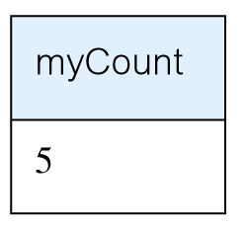
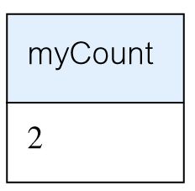
Use of COUNT(*)
Example:
How many properties cost more than £350 per month to rent?
SELECT COUNT(*) AS myCount
FROM PropertyForRent
WHERE rent > 350;
How many different properties viewed in May ‘13?
SELECT COUNT(DISTINCT propertyNo) AS myCount
FROM Viewing
WHERE viewDate BETWEEN ‘1-May-13’
AND ‘31-May-13’;

Slide 33
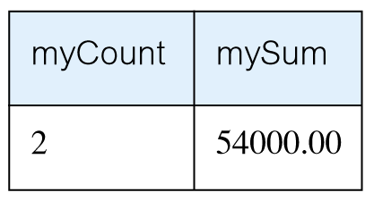
Use of COUNT and SUM
Example:
Find number of Managers and sum of their salaries.
SELECT COUNT(staffNo) AS myCount, SUM(salary) AS mySum
FROM Staff
WHERE position = ‘Manager’;

Slide 34
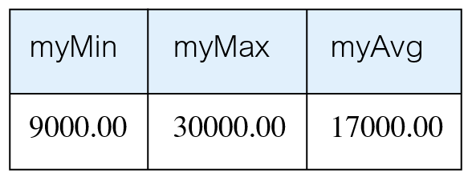
Use of MIN, MAX, AVG
Example:
Find minimum, maximum, and average staff salary.
SELECT MIN(salary) AS myMin,
MAX(salary) AS myMax,
AVG(salary) AS myAvg
FROM Staff;

Slide 35
SELECT Statement - Grouping
Use GROUP BY clause to get sub-totals.
SELECT and GROUP BY closely integrated: each item in SELECT list must be single-valued per group, and SELECT clause may only contain:
column names
aggregate functions
constants
expression involving combinations of the above.
All column names in SELECT list must appear in GROUP BY clause unless name is used only in an aggregate function.
If WHERE is used with GROUP BY, WHERE is applied first, then groups are formed from remaining rows satisfying predicate.
ISO considers two nulls to be equal for purposes of GROUP BY.

Slide 36
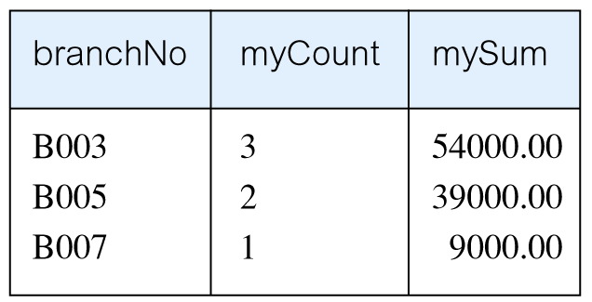
Use of GROUP BY
Example:
Find number of staff in each branch and their total salaries.
SELECT branchNo, COUNT(staffNo) AS myCount, SUM(salary) AS mySum
FROM Staff
GROUP BY branchNo
ORDER BY branchNo;

Slide 37
Restricted Groupings – HAVING clause
HAVING clause is designed for use with GROUP BY to restrict groups that appear in final result table.
Similar to WHERE, but WHERE filters individual rows whereas HAVING filters groups.
Column names in HAVING clause must also appear in the GROUP BY list or be contained within an aggregate function.

Slide 38
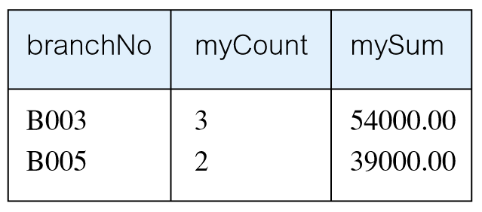
Use of HAVING
Example:
For each branch with more than 1 member of staff, find number of staff in each branch and sum of their salaries.
SELECT branchNo, COUNT(staffNo) AS myCount, SUM(salary) AS mySum
FROM Staff
GROUP BY branchNo
HAVING COUNT(staffNo) > 1
ORDER BY branchNo;

Slide 39
Subqueries
Some SQL statements can have a SELECT embedded within them.
A subselect can be used in WHERE and HAVING clauses of an outer SELECT, where it is called a subquery or nested query.
Subselects may also appear in INSERT, UPDATE, and DELETE statements.

Slide 40
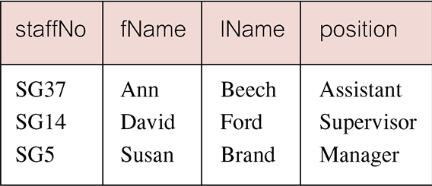
Subquery with Equality
Example:
List staff who work in branch at ‘163 Main St’.
SELECT staffNo, fName, lName, position
FROM Staff
WHERE branchNo =
(SELECT branchNo
FROM Branch
WHERE street = ‘163 Main St’);
Inner SELECT finds branch number for branch at ‘163 Main St’ (‘B003’).
Outer SELECT then retrieves details of all staff who work at this branch.
Outer SELECT then becomes:
SELECT staffNo, fName, lName, position
FROM Staff
WHERE branchNo = ‘B003’;

Slide 41
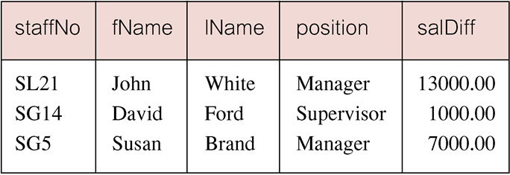
Subquery with Aggregate
Example:
List all staff whose salary is greater than the average salary, and show by how much.
SELECT staffNo, fName, lName, position, salary – (SELECT AVG(salary) FROM Staff) As SalDiff
FROM Staff
WHERE salary >(SELECT AVG(salary)
FROM Staff);
Cannot write ‘WHERE salary > AVG(salary)’
Instead, use subquery to find average salary (17000), and then use outer SELECT to find those staff with salary greater than this:
SELECT staffNo, fName, lName, position,
salary – 17000 As salDiff
FROM Staff
WHERE salary > 17000;

Slide 42
Subquery Rules
ORDER BY clause may not be used in a subquery (although it may be used in outermost SELECT).
Subquery SELECT list must consist of a single column name or expression, except for subqueries that use EXISTS.
By default, column names refer to table name in FROM clause of subquery. Can refer to a table in FROM using an alias.
When subquery is an operand in a comparison, subquery must appear on right-hand side.
A subquery may not be used as an operand in an expression.

Slide 43
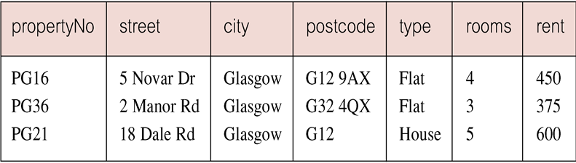
Nested subquery: use of IN
Example:
List properties handled by staff at ‘163 Main St’.
SELECT propertyNo, street, city, postcode, type, rooms, rent
FROM PropertyForRent
WHERE staffNo IN
(SELECT staffNo
FROM Staff
WHERE branchNo =
(SELECT branchNo
FROM Branch
WHERE street = ‘163 Main St’));

Slide 44
ANY and ALL
ANY and ALL may be used with subqueries that produce a single column of numbers.
With ALL, condition will only be true if it is satisfied by all values produced by subquery.
With ANY, condition will be true if it is satisfied by any values produced by subquery.
If subquery is empty, ALL returns true, ANY returns false.
SOME may be used in place of ANY.

Slide 45
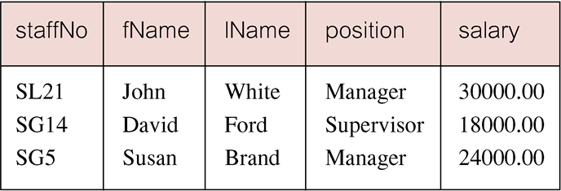
Use of ANY/SOME
Example:
Find staff whose salary is larger than salary of at least one member of staff at branch B003.
SELECT staffNo, fName, lName, position, salary
FROM Staff
WHERE salary > SOME (SELECT salary
FROM Staff
WHERE branchNo = ‘B003’);
Inner query produces set {12000, 18000, 24000} and outer query selects those staff whose salaries are greater than any of the values in this set.

Slide 46
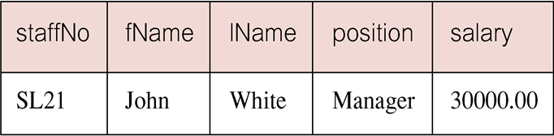
Use of ALL
Example:
Find staff whose salary is larger than salary of every member of staff at branch B003.
SELECT staffNo, fName, lName, position, salary
FROM Staff
WHERE salary > ALL(SELECT salary
FROM Staff
WHERE branchNo = ‘B003’);

Slide 47
Multi-Table Queries
Can use subqueries provided result columns come from same table.
If result columns come from more than one table must use a join.
To perform join, include more than one table in FROM clause.
Use comma as separator and typically include WHERE clause to specify join column(s).
Also possible to use an alias for a table named in FROM clause.
Alias is separated from table name with a space.
Alias can be used to qualify column names when there is ambiguity.

Slide 48
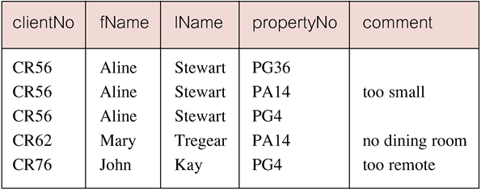
Example: Simple Join
List names of all clients who have viewed a property along with any comment supplied.
SELECT c.clientNo, fName, lName, propertyNo, comment
FROM Client c, Viewing v
WHERE c.clientNo = v.clientNo;
Only those rows from both tables that have identical values in the clientNo columns (c.clientNo = v.clientNo) are included in result.
Equivalent to equi-join in relational algebra.

Slide 49
Alternative JOIN Constructs
SQL provides alternative ways to specify joins:
FROM Client c JOIN Viewing v ON c.clientNo = v.clientNo
FROM Client JOIN Viewing USING clientNo
FROM Client NATURAL JOIN Viewing
In each case, FROM replaces original FROM and WHERE. However, first produces table with two identical clientNo columns.

Slide 50
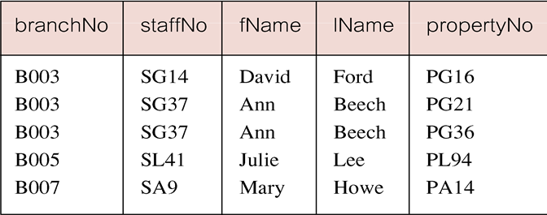
Example: Sorting a join
For each branch, list numbers and names of staff who manage properties, and properties they manage.
SELECT s.branchNo, s.staffNo, fName, lName, propertyNo
FROM Staff s, PropertyForRent p
WHERE s.staffNo = p.staffNo
ORDER BY s.branchNo, s.staffNo, propertyNo;

Slide 51
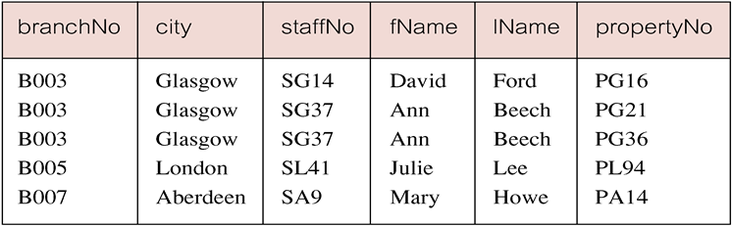
Example:Three Table Join
For each branch, list staff who manage properties, including city in which branch is located and properties they manage.
SELECT b.branchNo, b.city, s.staffNo, fName, lName, propertyNo
FROM Branch b, Staff s, PropertyForRent p
WHERE b.branchNo = s.branchNo AND s.staffNo = p.staffNo
ORDER BY b.branchNo, s.staffNo, propertyNo;
Alternative formulation for FROM and WHERE:
FROM (Branch b JOIN Staff s USING branchNo) AS
bs JOIN PropertyForRent p USING staffNo

Slide 52
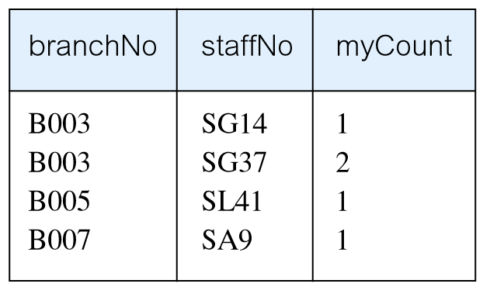
Example: Multiple Grouping Columns
Find number of properties handled by each staff member.
SELECT s.branchNo, s.staffNo, COUNT(*) AS myCount
FROM Staff s, PropertyForRent p
WHERE s.staffNo = p.staffNo
GROUP BY s.branchNo, s.staffNo
ORDER BY s.branchNo, s.staffNo;

Slide 53
Computing a Join
Procedure for generating results of a join are:
Form Cartesian product of the tables named in FROM clause.
If there is a WHERE clause, apply the search condition to each row of the product table, retaining those rows that satisfy the condition.
For each remaining row, determine value of each item in SELECT list to produce a single row in result table.4
If DISTINCT has been specified, eliminate any duplicate rows from the result table.
If there is an ORDER BY clause, sort result table as required.
SQL provides special format of SELECT for Cartesian product:
SELECT [DISTINCT | ALL] {* | columnList}
FROM Table1 CROSS JOIN Table2

Slide 54
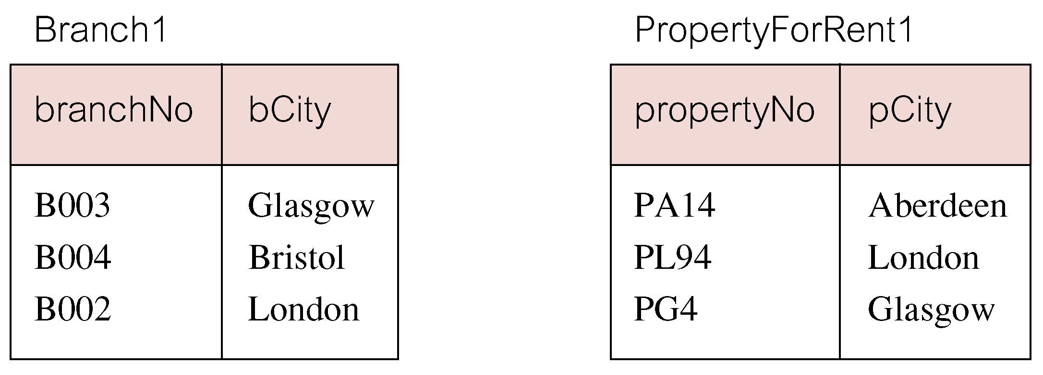
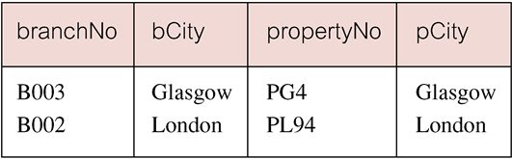
Outer Joins
If one row of a joined table is unmatched, row is omitted from result table.
Outer join operations retain rows that do not satisfy the join condition.
Consider following tables:
The (inner) join of these two tables:
SELECT b.*, p.*
FROM Branch1 b, PropertyForRent1 p
WHERE b.bCity = p.pCity;

Slide 55
Outer Joins
Result table has two rows where cities are same.
There are no rows corresponding to branches in Bristol and Aberdeen.
To include unmatched rows in result table, use an Outer join.

Slide 56
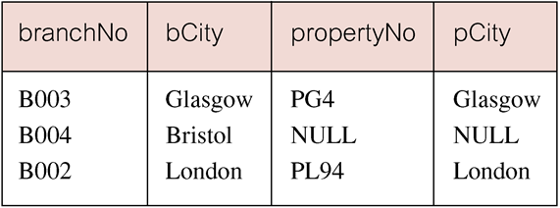
Example: Left Outer Join
List branches and properties that are in same city along with any unmatched branches.
SELECT b.*, p.*
FROM Branch1 b LEFT JOIN
PropertyForRent1 p ON b.bCity = p.pCity;
Includes those rows of first (left) table unmatched with rows from second (right) table.
Columns from second table are filled with NULLs.

Slide 57
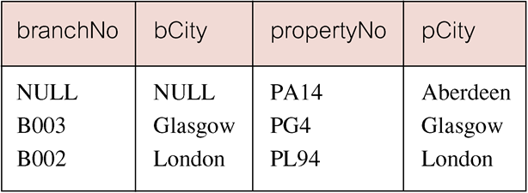
Example: Right Outer Join
List branches and properties in same city and any unmatched properties.
SELECT b.*, p.*
FROM Branch1 b RIGHT JOIN PropertyForRent1 p ON b.bCity = p.pCity;
Right Outer join includes those rows of second (right) table that are unmatched with rows from first (left) table.
Columns from first table are filled with NULLs.

Slide 58
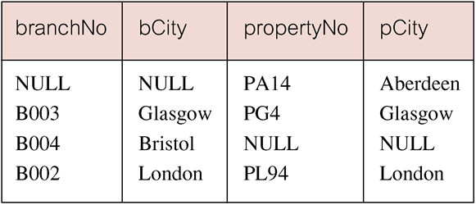
Example: Full Outer Join
List branches and properties in same city and any unmatched branches or properties.
SELECT b.*, p.*
FROM Branch1 b FULL JOIN PropertyForRent1 p ON b.bCity = p.pCity;
Includes rows that are unmatched in both tables.
Unmatched columns are filled with NULLs.

Slide 59
EXISTS and NOT EXISTS
EXISTS and NOT EXISTS are for use only with subqueries.
Produce a simple true/false result.
True if and only if there exists at least one row in result table returned by subquery.
False if subquery returns an empty result table.
NOT EXISTS is the opposite of EXISTS.
As (NOT) EXISTS check only for existence or non-existence of rows in subquery result table, subquery can contain any number of columns.
Common for subqueries following (NOT) EXISTS to be of form:
(SELECT * ...)

Slide 60
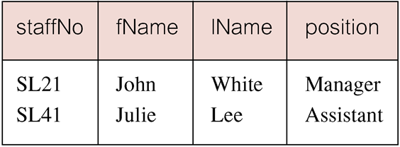
Example: Query using EXISTS
Find all staff who work in a London branch.
SELECT staffNo, fName, lName, position
FROM Staff s
WHERE EXISTS
(SELECT *
FROM Branch b
WHERE s.branchNo = b.branchNo AND
city = ‘London’);

Slide 61
Example: Query using EXISTS
Note, search condition s.branchNo = b.branchNo is necessary to consider correct branch record for each member of staff.
If omitted, would get all staff records listed out because subquery:
SELECT * FROM Branch WHERE city=‘London’
would always be true and query would be:
SELECT staffNo, fName, lName, position FROM Staff
WHERE true;
Could also write this query using join construct:
SELECT staffNo, fName, lName, position
FROM Staff s, Branch b
WHERE s.branchNo = b.branchNo AND city = ‘London’;

Slide 62
Union, Intersect, and Difference (Except)
Can use normal set operations of Union, Intersection, and Difference to combine results of two or more queries into a single result table.
Union of two tables, A and B, is table containing all rows in either A or B or both.
Intersection is table containing all rows common to both A and B.
Difference is table containing all rows in A but not in B.
Two tables must be union compatible.
Format of set operator clause in each case is:
op [ALL] [CORRESPONDING [BY {column1 [, ...]}]]
If CORRESPONDING BY specified, set operation performed on the named column(s).
If CORRESPONDING specified but not BY clause, operation performed on common columns.
If ALL specified, result can include duplicate rows.

Slide 63
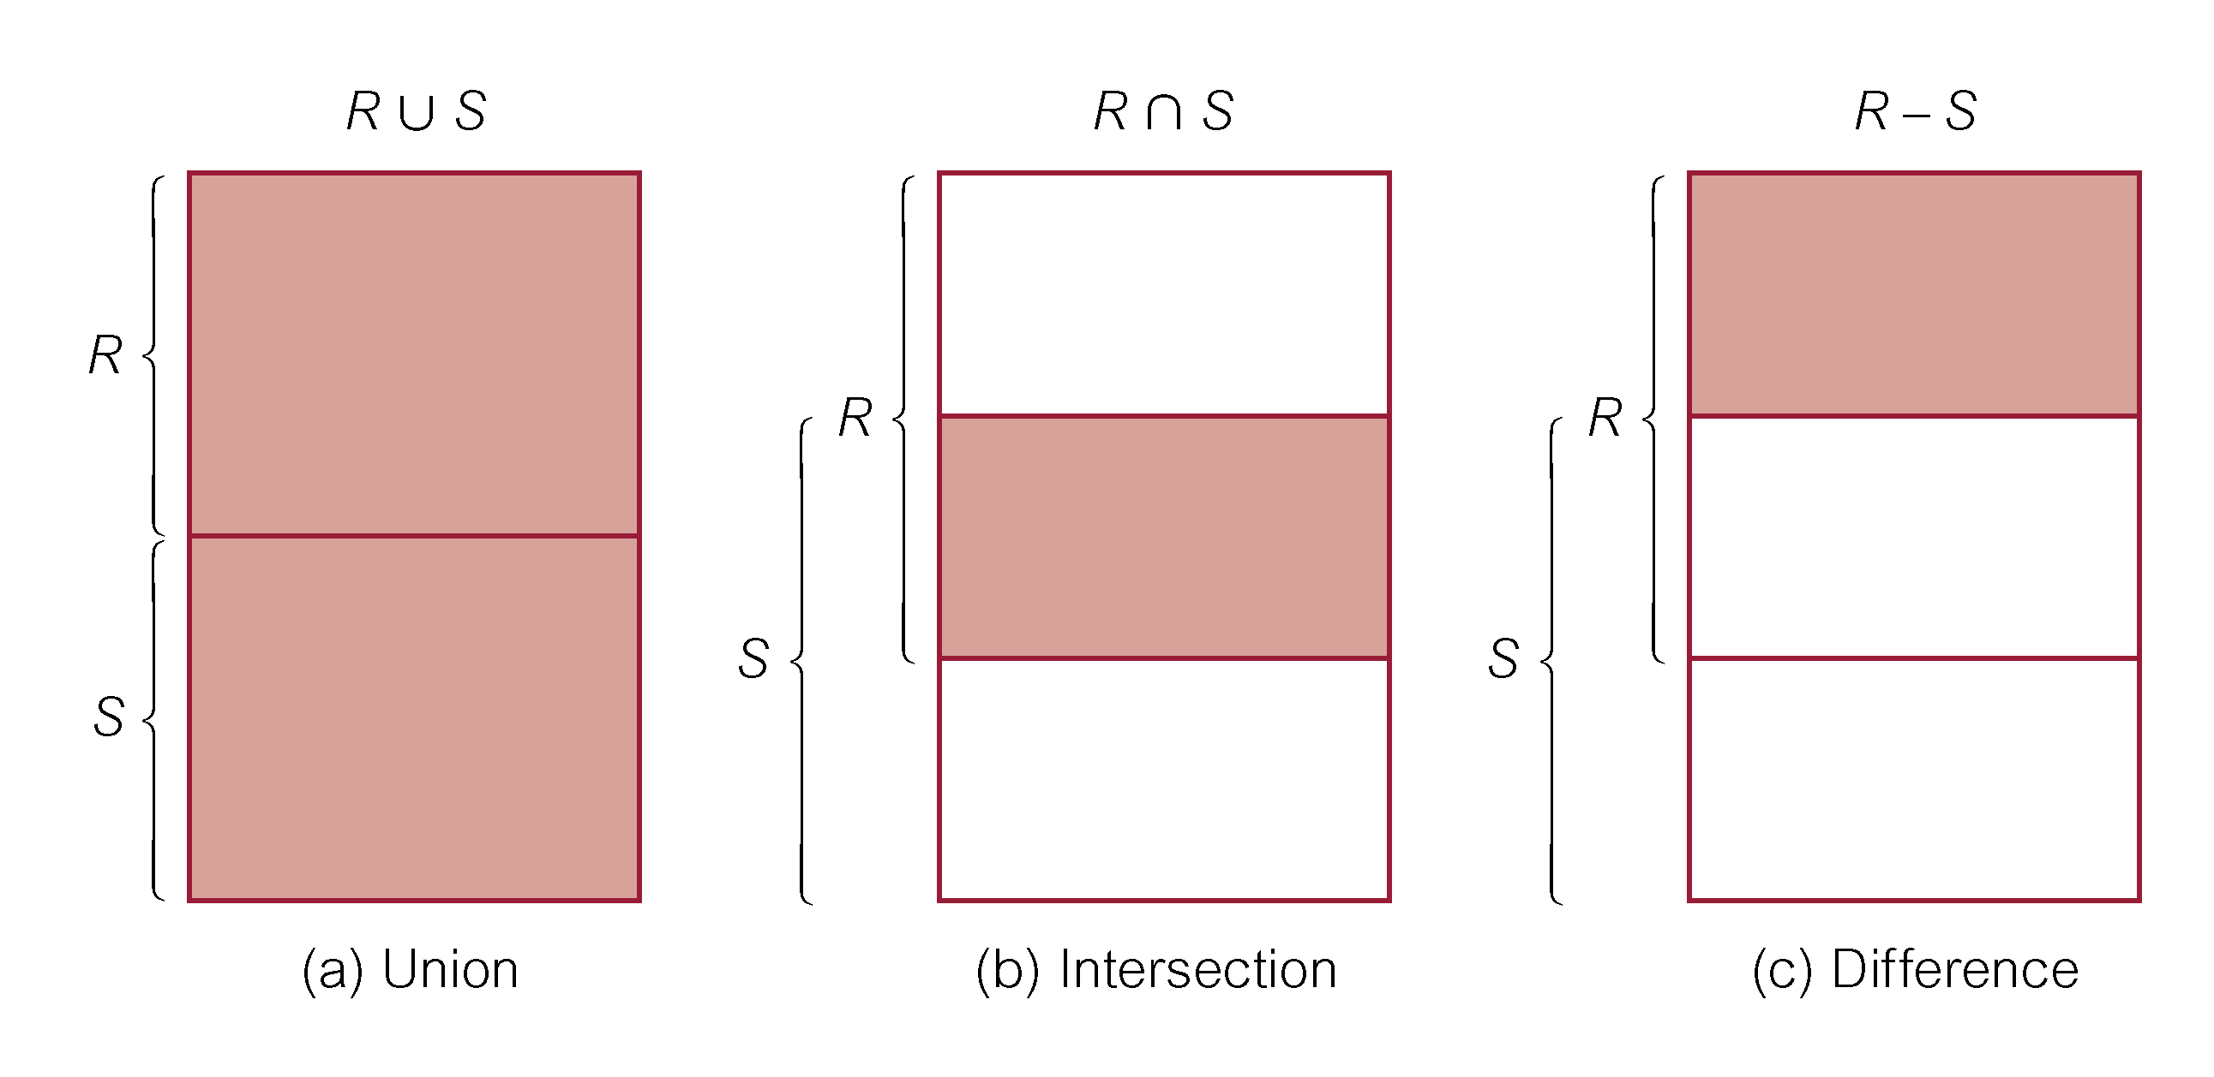
Union, Intersect, and Difference (Except)

Slide 64
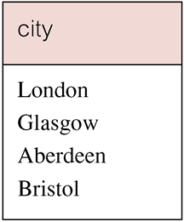
Example: Use of UNION
List all cities where there is either a branch office or a property.
(SELECT city
FROM Branch
WHERE city IS NOT NULL) UNION
(SELECT city
FROM PropertyForRent
WHERE city IS NOT NULL);
Or
(SELECT * FROM Branch WHERE city IS NOT NULL) UNION CORRESPONDING BY city (SELECT * FROM PropertyForRent WHERE city IS NOT NULL);
Produces result tables from both queries and merges both tables together.

Slide 65
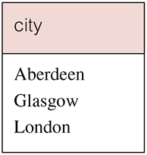
Example: Use of INTERSECT
List all cities where there is both a branch office and a property.
(SELECT city FROM Branch)
INTERSECT
(SELECT city FROM PropertyForRent);
Or
(SELECT * FROM Branch)
INTERSECT CORRESPONDING BY city
(SELECT * FROM PropertyForRent);

Slide 66
Example: Use of INTERSECT
Could rewrite this query without INTERSECT operator:
SELECT b.city
FROM Branch b PropertyForRent p
WHERE b.city = p.city;
Or:
SELECT DISTINCT city FROM Branch b
WHERE EXISTS
(SELECT * FROM PropertyForRent p
WHERE p.city = b.city);

Slide 67
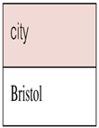
Example: Use of EXCEPT
List of all cities where there is a branch office but no properties.
(SELECT city FROM Branch)
EXCEPT
(SELECT city FROM PropertyForRent);
Or
(SELECT * FROM Branch)
EXCEPT CORRESPONDING BY city
(SELECT * FROM PropertyForRent);

Slide 68
Example: Use of EXCEPT
Could rewrite this query without EXCEPT:
SELECT DISTINCT city FROM Branch
WHERE city NOT IN
(SELECT city FROM PropertyForRent);
Or
SELECT DISTINCT city FROM Branch b
WHERE NOT EXISTS
(SELECT * FROM PropertyForRent p
WHERE p.city = b.city);

Slide 69
INSERT
INSERT INTO TableName [ (columnList) ]
VALUES (dataValueList)
columnList is optional; if omitted, SQL assumes a list of all columns in their original CREATE TABLE order.
Any columns omitted must have been declared as NULL when table was created, unless DEFAULT was specified when creating column.
dataValueList must match columnList as follows:
number of items in each list must be same;
must be direct correspondence in position of items in two lists;
data type of each item in dataValueList must be compatible with data type of corresponding column.

Slide 70
Example: INSERT … VALUES
Insert a new row into Staff table supplying data for all columns.
INSERT INTO Staff
VALUES (‘SG16’, ‘Alan’, ‘Brown’, ‘Assistant’, ‘M’, Date‘1957-05-25’, 8300, ‘B003’);

Slide 71
Example: INSERT using Defaults
Insert a new row into Staff table supplying data for all mandatory columns.
INSERT INTO Staff (staffNo, fName, lName,
position, salary, branchNo)
VALUES (‘SG44’, ‘Anne’, ‘Jones’,
‘Assistant’, 8100, ‘B003’);
Or
INSERT INTO Staff
VALUES (‘SG44’, ‘Anne’, ‘Jones’, ‘Assistant’, NULL,
NULL, 8100, ‘B003’);

Slide 72
INSERT … SELECT
Second form of INSERT allows multiple rows to be copied from one or more tables to another:
INSERT INTO TableName [ (columnList) ]
SELECT ...

Slide 73
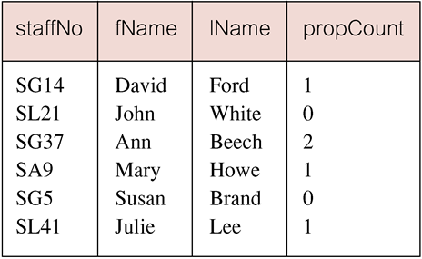
Example: INSERT … SELECT
Assume there is a table StaffPropCount that contains names of staff and number of properties they manage:
StaffPropCount(staffNo, fName, lName, propCnt)
Populate StaffPropCount using Staff and PropertyForRent tables.
Example:
INSERT INTO StaffPropCount
(SELECT s.staffNo, fName, lName, COUNT(*)
FROM Staff s, PropertyForRent p
WHERE s.staffNo = p.staffNo
GROUP BY s.staffNo, fName, lName)
UNION
(SELECT staffNo, fName, lName, 0
FROM Staff
WHERE staffNo NOT IN
(SELECT DISTINCT staffNo
FROM PropertyForRent));
If second part of UNION is omitted, excludes those staff who currently do not manage any properties.

Slide 74
UPDATE
UPDATE TableName
SET columnName1 = dataValue1
[, columnName2 = dataValue2...]
[WHERE searchCondition]
TableName can be name of a base table or an updatable view.
SET clause specifies names of one or more columns that are to be updated.
WHERE clause is optional:
if omitted, named columns are updated for all rows in table;
if specified, only those rows that satisfy searchCondition are updated.
New dataValue(s) must be compatible with data type for corresponding column.

Slide 75
Example: UPDATE All Rows
Give all staff a 3% pay increase.
UPDATE Staff
SET salary = salary*1.03;
Give all Managers a 5% pay increase.
UPDATE Staff
SET salary = salary*1.05
WHERE position = ‘Manager’;

Slide 76
Example: UPDATE Multiple Columns
Promote David Ford (staffNo=‘SG14’) to Manager and change his salary to £18,000.
UPDATE Staff
SET position = ‘Manager’, salary = 18000
WHERE staffNo = ‘SG14’;

Slide 77
DELETE
DELETE FROM TableName
[WHERE searchCondition]
TableName can be name of a base table or an updatable view.
searchCondition is optional; if omitted, all rows are deleted from table. This does not delete table. If search_condition is specified, only those rows that satisfy condition are deleted.

Slide 78
Example: DELETE Specific Rows
Delete all viewings that relate to property PG4.
DELETE FROM Viewing
WHERE propertyNo = ‘PG4’;
Delete all records from the Viewing table.
DELETE FROM Viewing;

Slide 79
SQL – Data Definition

Slide 80
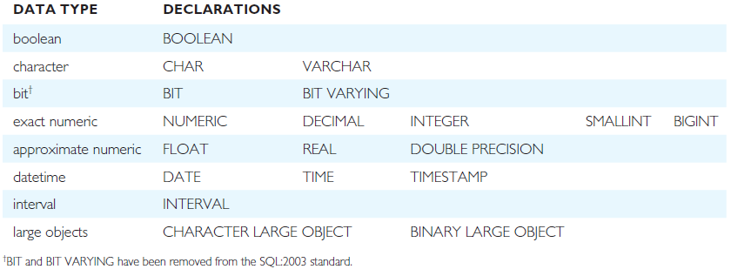
ISO SQL Data Types

Slide 81
Integrity Enhancement Feature
Consider five types of integrity constraints:
required data
domain constraints
entity integrity
referential integrity
general constraints.

Slide 82
Integrity Enhancement Feature
Required Data
position VARCHAR(10) NOT NULL
Domain Constraints
(a) CHECK
sex CHAR NOT NULL CHECK (sex IN (‘M’, ‘F’))
(b) CREATE DOMAIN
CREATE DOMAIN DomainName [AS] dataType
[DEFAULT defaultOption]
[CHECK (searchCondition)]
For example:
CREATE DOMAIN SexType AS CHAR
CHECK (VALUE IN (‘M’, ‘F’));
sex SexType NOT NULL

Slide 83
Integrity Enhancement Feature (IEF)
searchCondition can involve a table lookup:
CREATE DOMAIN BranchNo AS CHAR(4)
CHECK (VALUE IN (SELECT branchNo
FROM Branch));
Domains can be removed using DROP DOMAIN:
DROP DOMAIN DomainName
[RESTRICT | CASCADE]

Slide 84
IEF - Entity Integrity
Primary key of a table must contain a unique, non-null value for each row.
ISO standard supports FOREIGN KEY clause in CREATE and ALTER TABLE statements:
PRIMARY KEY(staffNo)
PRIMARY KEY(clientNo, propertyNo)
Can only have one PRIMARY KEY clause per table. Can still ensure uniqueness for alternate keys using UNIQUE:
UNIQUE(telNo)

Slide 85
IEF - Referential Integrity
FK is column or set of columns that links each row in child table containing foreign FK to row of parent table containing matching PK.
Referential integrity means that, if FK contains a value, that value must refer to existing row in parent table.
ISO standard supports definition of FKs with FOREIGN KEY clause in CREATE and ALTER TABLE:
FOREIGN KEY(branchNo) REFERENCES Branch
Any INSERT/UPDATE attempting to create FK value in child table without matching CK value in parent is rejected.
Action taken attempting to update/delete a CK value in parent table with matching rows in child is dependent on referential action specified using ON UPDATE and ON DELETE subclauses:
CASCADE - SET NULL
SET DEFAULT - NO ACTION

Slide 86
IEF - Referential Integrity
CASCADE: Delete row from parent and delete matching rows in child, and so on in cascading manner.
SET NULL: Delete row from parent and set FK column(s) in child to NULL. Only valid if FK columns are NOT NULL.
SET DEFAULT: Delete row from parent and set each component of FK in child to specified default. Only valid if DEFAULT specified for FK columns.
NO ACTION: Reject delete from parent. Default.
FOREIGN KEY (staffNo) REFERENCES Staff ON DELETE SET NULL
FOREIGN KEY (ownerNo) REFERENCES Owner ON UPDATE CASCADE

Slide 87
IEF - General Constraints
Could use CHECK/UNIQUE in CREATE and ALTER TABLE.
Similar to the CHECK clause, also have:
CREATE ASSERTION AssertionName
CHECK (searchCondition)
CREATE ASSERTION StaffNotHandlingTooMuch
CHECK (NOT EXISTS (SELECT staffNo
FROM PropertyForRent
GROUP BY staffNo
HAVING COUNT(*) > 100))

Slide 88
Data Definition
SQL DDL allows database objects such as schemas, domains, tables, views, and indexes to be created and destroyed.
Main SQL DDL statements are:
CREATE SCHEMA DROP SCHEMA
CREATE/ALTER DOMAIN DROP DOMAIN
CREATE/ALTER TABLE DROP TABLE
CREATE VIEW DROP VIEW
Many DBMSs also provide:
CREATE INDEX DROP INDEX

Slide 89
Data Definition
Relations and other database objects exist in an environment.
Each environment contains one or more catalogs, and each catalog consists of set of schemas.
Schema is named collection of related database objects.
Objects in a schema can be tables, views, domains, assertions, collations, translations, and character sets. All have same owner.

Slide 90
CREATE SCHEMA
CREATE SCHEMA [Name |
AUTHORIZATION CreatorId ]
DROP SCHEMA Name [RESTRICT | CASCADE ]
With RESTRICT (default), schema must be empty or operation fails.
With CASCADE, operation cascades to drop all objects associated with schema in order defined above. If any of these operations fail, DROP SCHEMA fails.

Slide 91
CREATE TABLE
CREATE TABLE TableName
{(colName dataType [NOT NULL] [UNIQUE]
[DEFAULT defaultOption]
[CHECK searchCondition] [,...]}
[PRIMARY KEY (listOfColumns),]
{[UNIQUE (listOfColumns),] […,]}
{[FOREIGN KEY (listOfFKColumns)
REFERENCES ParentTableName [(listOfCKColumns)],
[ON UPDATE referentialAction]
[ON DELETE referentialAction ]] [,…]}
{[CHECK (searchCondition)] [,…] })

Slide 92
CREATE TABLE
Creates a table with one or more columns of the specified dataType.
With NOT NULL, system rejects any attempt to insert a null in the column.
Can specify a DEFAULT value for the column.
Primary keys should always be specified as NOT NULL.
FOREIGN KEY clause specifies FK along with the referential action.

Slide 93
Example: CREATE TABLE
CREATE DOMAIN OwnerNumber AS VARCHAR(5)
CHECK (VALUE IN (SELECT ownerNo FROM PrivateOwner));
CREATE DOMAIN StaffNumber AS VARCHAR(5)
CHECK (VALUE IN (SELECT staffNo FROM Staff));
CREATE DOMAIN PNumber AS VARCHAR(5);
CREATE DOMAIN PRooms AS SMALLINT;
CHECK(VALUE BETWEEN 1 AND 15);
CREATE DOMAIN PRent AS DECIMAL(6,2)
CHECK(VALUE BETWEEN 0 AND 9999.99);

Slide 94
Example: CREATE TABLE
CREATE TABLE PropertyForRent (
propertyNo PNumber NOT NULL, ….
rooms PRooms NOT NULL DEFAULT 4,
rent PRent NOT NULL, DEFAULT 600,
ownerNo OwnerNumber NOT NULL,
staffNo StaffNumber
Constraint StaffNotHandlingTooMuch ….
branchNo BranchNumber NOT NULL,
PRIMARY KEY (propertyNo),
FOREIGN KEY (staffNo) REFERENCES Staff
ON DELETE SET NULL ON UPDATE CASCADE ….);

Slide 95
ALTER TABLE
Add a new column to a table.
Drop a column from a table.
Add a new table constraint.
Drop a table constraint.
Set a default for a column.
Drop a default for a column.

Slide 96
Example: ALTER TABLE
Change Staff table by removing default of ‘Assistant’ for position column and setting default for sex column to female (‘F’).
ALTER TABLE Staff
ALTER position DROP DEFAULT;
ALTER TABLE Staff
ALTER sex SET DEFAULT ‘F’;

Slide 97
Example: ALTER TABLE
Remove constraint from PropertyForRent that staff are not allowed to handle more than 100 properties at a time. Add new column to Client table.
ALTER TABLE PropertyForRent
DROP CONSTRAINT StaffNotHandlingTooMuch;
ALTER TABLE Client
ADD prefNoRooms PRooms;

Slide 98
DROP TABLE
DROP TABLE TableName [RESTRICT | CASCADE]
e.g. DROP TABLE PropertyForRent;
Removes named table and all rows within it.
With RESTRICT, if any other objects depend for their existence on continued existence of this table, SQL does not allow request.
With CASCADE, SQL drops all dependent objects (and objects dependent on these objects).

Slide 99
Views
View
Dynamic result of one or more relational operations operating on base relations to produce another relation.
Virtual relation that does not necessarily actually exist in the database but is produced upon request, at time of request.

Slide 100
Views
Contents of a view are defined as a query on one or more base relations.
With view resolution, any operations on view are automatically translated into operations on relations from which it is derived.
With view materialization, the view is stored as a temporary table, which is maintained as the underlying base tables are updated.

Slide 101
SQL - CREATE VIEW
CREATE VIEW ViewName [ (newColumnName [,...]) ]
AS subselect
[WITH [CASCADED | LOCAL] CHECK OPTION]
Can assign a name to each column in view.
If list of column names is specified, it must have same number of items as number of columns produced by subselect.
If omitted, each column takes name of corresponding column in subselect.

Slide 102
SQL - CREATE VIEW
List must be specified if there is any ambiguity in a column name.
The subselect is known as the defining query.
WITH CHECK OPTION ensures that if a row fails to satisfy WHERE clause of defining query, it is not added to underlying base table.
Need SELECT privilege on all tables referenced in subselect and USAGE privilege on any domains used in referenced columns.

Slide 103
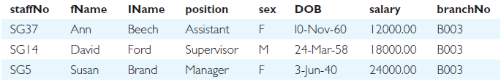
Example: Create Horizontal View
Create view so that manager at branch B003 can only see details for staff who work in his or her office.
CREATE VIEW Manager3Staff
AS SELECT *
FROM Staff
WHERE branchNo = ‘B003’;

Slide 104
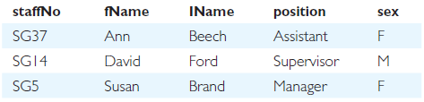
Example: Create Vertical View
Create view of staff details at branch B003 excluding salaries.
CREATE VIEW Staff3
AS SELECT staffNo, fName, lName, position, sex
FROM Staff
WHERE branchNo = ‘B003’;

Slide 105

Example: Grouped and Joined Views
Create view of staff who manage properties for rent, including branch number they work at, staff number, and number of properties they manage.
CREATE VIEW StaffPropCnt (branchNo, staffNo, cnt)
AS SELECT s.branchNo, s.staffNo, COUNT(*)
FROM Staff s, PropertyForRent p
WHERE s.staffNo = p.staffNo
GROUP BY s.branchNo, s.staffNo;

Slide 106
SQL - DROP VIEW
DROP VIEW ViewName [RESTRICT | CASCADE]
Causes definition of view to be deleted from database.
For example:
DROP VIEW Manager3Staff;
With CASCADE, all related dependent objects are deleted; i.e. any views defined on view being dropped.
With RESTRICT (default), if any other objects depend for their existence on continued existence of view being dropped, command is rejected

Slide 107
View Resolution
Count number of properties managed by each member at branch B003.
SELECT staffNo, cnt
FROM StaffPropCnt
WHERE branchNo = ‘B003’
ORDER BY staffNo;

Slide 108
View Resolution
View column names in SELECT list are translated into their corresponding column names in the defining query:
SELECT s.staffNo As staffNo, COUNT(*) As cnt
View names in FROM are replaced with corresponding FROM lists of defining query:
FROM Staff s, PropertyForRent p
WHERE from user query is combined with WHERE of defining query using AND:
WHERE s.staffNo = p.staffNo AND branchNo = ‘B003’
GROUP BY and HAVING clauses copied from defining query:
GROUP BY s.branchNo, s.staffNo

Slide 109
View Resolution
ORDER BY copied from query with view column name translated into defining query column name
ORDER BY s.staffNo
Final merged query is now executed to produce the result:
SELECT s.staffNo AS staffNo, COUNT(*) AS cnt
FROM Staff s, PropertyForRent p
WHERE s.staffNo = p.staffNo AND
branchNo = ‘B003’
GROUP BY s.branchNo, s.staffNo
ORDER BY s.staffNo;

Slide 110
Restrictions on Views
SQL imposes several restrictions on creation and use of views.
If column in view is based on an aggregate function:
Column may appear only in SELECT and ORDER BY clauses of queries that access view.
Column may not be used in WHERE nor be an argument to an aggregate function in any query based on view.
For example, following query would fail:
SELECT COUNT(cnt)
FROM StaffPropCnt;
Similarly, following query would also fail:
SELECT *
FROM StaffPropCnt
WHERE cnt > 2;

Slide 111
Restrictions on Views
Grouped view may never be joined with a base table or a view.
For example, StaffPropCnt view is a grouped view, so any attempt to join this view with another table or view fails.

Slide 112
View Updatability
All updates to base table reflected in all views that encompass base table.
Similarly, may expect that if view is updated then base table(s) will reflect change.
However, consider again view StaffPropCnt.
If we tried to insert record showing that at branch B003, SG5 manages 2 properties:
INSERT INTO StaffPropCnt
VALUES (‘B003’, ‘SG5’, 2);
Have to insert 2 records into PropertyForRent showing which properties SG5 manages. However, do not know which properties they are; i.e. do not know primary keys!

Slide 113
View Updatability
If change definition of view and replace count with actual property numbers:
CREATE VIEW StaffPropList (branchNo, staffNo, propertyNo)
AS SELECT s.branchNo, s.staffNo, p.propertyNo
FROM Staff s, PropertyForRent p
WHERE s.staffNo = p.staffNo;
Now try to insert the record:
INSERT INTO StaffPropList
VALUES (‘B003’, ‘SG5’, ‘PG19’);
Still problem, because in PropertyForRent all columns except postcode/staffNo are not allowed nulls.
However, have no way of giving remaining non-null columns values.

Slide 114
View Updatability
ISO specifies that a view is updatable if and only if:
DISTINCT is not specified.
Every element in SELECT list of defining query is a column name and no column appears more than once.
FROM clause specifies only one table, excluding any views based on a join, union, intersection or difference.
No nested SELECT referencing outer table.
No GROUP BY or HAVING clause.
Also, every row added through view must not violate integrity constraints of base table.

Slide 115
Updatable View
For view to be updatable, DBMS must be able to trace any row or column back to its row or column in the source table.

Slide 116
WITH CHECK OPTION
Rows exist in a view because they satisfy WHERE condition of defining query.
If a row changes and no longer satisfies condition, it disappears from the view.
New rows appear within view when insert/update on view cause them to satisfy WHERE condition.
Rows that enter or leave a view are called migrating rows.
WITH CHECK OPTION prohibits a row migrating out of the view.
LOCAL/CASCADED apply to view hierarchies.
With LOCAL, any row insert/update on view and any view directly or indirectly defined on this view must not cause row to disappear from view unless row also disappears from derived view/table.
With CASCADED (default), any row insert/ update on this view and on any view directly or indirectly defined on this view must not cause row to disappear from the view.

Slide 117
Example: WITH CHECK OPTION
CREATE VIEW Manager3Staff
AS SELECT *
FROM Staff
WHERE branchNo = ‘B003’
WITH CHECK OPTION;
Cannot update branch number of row B003 to B002 as this would cause row to migrate from view.
Also cannot insert a row into view with a branch number that does not equal B003.

Slide 118
Example: WITH CHECK OPTION
Now consider the following:
CREATE VIEW LowSalary
AS SELECT * FROM Staff WHERE salary > 9000;
CREATE VIEW HighSalary
AS SELECT * FROM LowSalary
WHERE salary > 10000
WITH LOCAL CHECK OPTION;
CREATE VIEW Manager3Staff
AS SELECT * FROM HighSalary
WHERE branchNo = ‘B003’;

Slide 119
Example: WITH CHECK OPTION
UPDATE Manager3Staff
SET salary = 9500
WHERE staffNo = ‘SG37’;
This update would fail: although update would cause row to disappear from HighSalary, row would not disappear from LowSalary.
However, if update tried to set salary to 8000, update would succeed as row would no longer be part of LowSalary.

Slide 120
Example 7.6 - WITH CHECK OPTION
If HighSalary had specified WITH CASCADED CHECK OPTION, setting salary to 9500 or 8000 would be rejected because row would disappear from HighSalary.
To prevent anomalies like this, each view should be created using WITH CASCADED CHECK OPTION.
Pearson Education © 2014
120

Slide 121
Advantages of Views
Data independence
Currency
Improved security
Reduced complexity
Convenience
Customization
Data integrity

Slide 122
Disadvantages of Views
Update restriction
Structure restriction
Performance

Slide 123
View Materialization
View resolution mechanism may be slow, particularly if view is accessed frequently.
View materialization stores view as temporary table when view is first queried.
Thereafter, queries based on materialized view can be faster than recomputing view each time.
Difficulty is maintaining the currency of view while base tables(s) are being updated.

Slide 124

View Maintenance
View maintenance aims to apply only those changes necessary to keep view current.
Consider following view:
CREATE VIEW StaffPropRent(staffNo)
AS SELECT DISTINCT staffNo
FROM PropertyForRent
WHERE branchNo = ‘B003’ AND
rent > 400;

Slide 125
View Materialization
If insert row into PropertyForRent with rent ≤400 then view would be unchanged.
If insert row for property PG24 at branch B003 with staffNo = SG19 and rent = 550, then row would appear in materialized view.
If insert row for property PG54 at branch B003 with staffNo = SG37 and rent = 450, then no new row would need to be added to materialized view.
If delete property PG24, row should be deleted from materialized view.
If delete property PG54, then row for PG37 should not be deleted (because of existing property PG21).

Slide 126
Transactions
SQL defines transaction model based on COMMIT and ROLLBACK.
Transaction is logical unit of work with one or more SQL statements guaranteed to be atomic with respect to recovery.
An SQL transaction automatically begins with a transaction-initiating SQL statement (e.g., SELECT, INSERT).
Changes made by transaction are not visible to other concurrently executing transactions until transaction completes.

Slide 127
Transactions
Transaction can complete in one of four ways:
COMMIT ends transaction successfully, making changes permanent.
ROLLBACK aborts transaction, backing out any changes made by transaction.
For programmatic SQL, successful program termination ends final transaction successfully, even if COMMIT has not been executed.
For programmatic SQL, abnormal program end aborts transaction.

Slide 128
Transactions
New transaction starts with next transaction-initiating statement.
SQL transactions cannot be nested.
SET TRANSACTION configures transaction:
SET TRANSACTION
[READ ONLY | READ WRITE] |
[ISOLATION LEVEL READ UNCOMMITTED |
READ COMMITTED|REPEATABLE READ |SERIALIZABLE ]

Slide 129
Immediate and Deferred Integrity Constraints
Do not always want constraints to be checked immediately, but instead at transaction commit.
Constraint may be defined as INITIALLY IMMEDIATE or INITIALLY DEFERRED, indicating mode the constraint assumes at start of each transaction.
In former case, also possible to specify whether mode can be changed subsequently using qualifier [NOT] DEFERRABLE.
Default mode is INITIALLY IMMEDIATE.

Slide 130
Immediate and Deferred Integrity Constraints
SET CONSTRAINTS statement used to set mode for specified constraints for current transaction:
SET CONSTRAINTS
{ALL | constraintName [, . . . ]}
{DEFERRED ¦ IMMEDIATE}

Slide 131
Access Control - Authorization Identifiers and Ownership
Authorization identifier is normal SQL identifier used to establish identity of a user. Usually has an associated password.
Used to determine which objects user may reference and what operations may be performed on those objects.
Each object created in SQL has an owner, as defined in AUTHORIZATION clause of schema to which object belongs.
Owner is only person who may know about it.

Slide 132
Privileges
Actions user permitted to carry out on given base table or view:
SELECT Retrieve data from a table.
INSERT Insert new rows into a table.
UPDATE Modify rows of data in a table.
DELETE Delete rows of data from a table.
REFERENCES Reference columns of named table in integrity constraints.
USAGE Use domains, collations, character sets, and translations.
Can restrict INSERT/UPDATE/REFERENCES to named columns.
Owner of table must grant other users the necessary privileges using GRANT statement.
To create view, user must have SELECT privilege on all tables that make up view and REFERENCES privilege on the named columns.

Slide 133
GRANT
GRANT {PrivilegeList | ALL PRIVILEGES}
ON ObjectName
TO {AuthorizationIdList | PUBLIC}
[WITH GRANT OPTION]
PrivilegeList consists of one or more of above privileges separated by commas.
ALL PRIVILEGES grants all privileges to a user.
PUBLIC allows access to be granted to all present and future authorized users.
ObjectName can be a base table, view, domain, character set, collation or translation.
WITH GRANT OPTION allows privileges to be passed on.

Slide 134
Example: GRANT
Give Manager full privileges to Staff table.
GRANT ALL PRIVILEGES
ON Staff
TO Manager WITH GRANT OPTION;
Give users Personnel and Director SELECT and UPDATE on column salary of Staff.
GRANT SELECT, UPDATE (salary)
ON Staff
TO Personnel, Director;

Slide 135
Example: GRANT Specific Privileges to PUBLIC
Give all users SELECT on Branch table.
GRANT SELECT
ON Branch
TO PUBLIC;

Slide 136
REVOKE
REVOKE takes away privileges granted with GRANT.
REVOKE [GRANT OPTION FOR]
{PrivilegeList | ALL PRIVILEGES}
ON ObjectName
FROM {AuthorizationIdList | PUBLIC}
[RESTRICT | CASCADE]
ALL PRIVILEGES refers to all privileges granted to a user by user revoking privileges.

Slide 137
REVOKE
GRANT OPTION FOR allows privileges passed on via WITH GRANT OPTION of GRANT to be revoked separately from the privileges themselves.
REVOKE fails if it results in an abandoned object, such as a view, unless the CASCADE keyword has been specified.
Privileges granted to this user by other users are not affected.

Slide 138

REVOKE

Slide 139
Example: REVOKE Specific Privileges
Revoke privilege SELECT on Branch table from all users.
REVOKE SELECT
ON Branch
FROM PUBLIC;
Revoke all privileges given to Director on Staff table.
REVOKE ALL PRIVILEGES
ON Staff
FROM Director;

Slide 140
Advanced SQL

Slide 141
The SQL Programming Language
Impedance mismatch
Mixing different programming paradigms
SQL is a declarative language
High-level language such as C is a procedural language
SQL and 3GLs use different models to represent data
SQL/PSM (Persistent Stored Modules)
PL/SQL (Procedural Language/SQL)
Oracle’s procedural extension to SQL
Two versions

Slide 142

Declarations
Variables and constant variables must be declared before they can be referenced
Possible to declare a variable as NOT NULL
%TYPE – variable same type as a column
vStaffNo Staff.staffNo%TYPE;
%ROWTYPE – variable same type as an entire row
vStaffNo1 Staff%ROWTYPE;

Slide 143
Assignments
Variables can be assigned in two ways:
Using the normal assignment statement (:=):
vStaffNo := ‘SG14’;
Using an SQL SELECT or FETCH statement:
SELECT COUNT(*) INTO x
FROM PropertyForRent
WHERE staffNo = vStaffNo;

Slide 144
Control Statements
Conditional IF statement
Conditional CASE statement
Iteration statement (LOOP)
Iteration statement (WHILE and REPEAT)
Iteration statement (FOR)

Slide 145
Conditional IF Statement
IF (position = ‘Manager’) THEN
salary := salary*1.05;
ELSE
salary := salary*1.05;
END IF;

Slide 146
Conditional CASE Statement
UPDATE Staff
SET salary = CASE
WHEN position = ‘Manager’
THEN salary * 1.05
ELSE
salary * 1.02
END;

Slide 147
Iteration Statement (LOOP)
x:=1;
myLoop:
LOOP
x := x+1;
IF (x > 3) THEN
EXIT myLoop; --- exit loop now
END LOOP myLoop;
--- control resumes here
y := 2;

Slide 148
Iteration Statement (WHILE and REPEAT)
WHILE (condition) DO
<SQL statement list>
END WHILE [labelName];
REPEAT
<SQL statement list>
UNTIL (condition)
END REPEAT [labelName];
148

Slide 149
Iteration Statement (FOR)
myLoop1:
FOR iStaff AS SELECT COUNT(*) FROM PropertyForRent WHERE staffNo = ‘SG14’ DO
…..
END FOR myLoop1;

Slide 150
Exceptions in PL/SQL
Exception
Identifier in PL/SQL
Raised during the execution of a block
Terminates block’s main body of actions
Exception handlers
Separate routines that handle raised exceptions
User-defined exception
Defined in the declarative part of a PL/SQL block

Slide 151

Example of Exception Handling in PL/SQL

Slide 152
Condition Handling
Define a handler by:
Specifying its type
Exception and completion conditions it can resolve
Action it takes to do so
Handler is activated:
When it is the most appropriate handler for the condition that has been raised by the SQL statement

Slide 153
The DECLARE . . . HANDLER Statement
DECLARE {CONTINUE | EXIT | UNDO} HANDLER FOR SQLSTATE {sqlstateValue | conditionName | SQLEXCEPTION |SQLWARNING | NOT FOUND} handlerAction;

Slide 154
Cursors in PL/SQL
Cursor
Allows the rows of a query result to be accessed one at a time
Must be declared and opened before use
Must be closed to deactivate it after it is no longer required
Updating rows through a cursor

Slide 155

Using Cursors in PL/SQL to Process a Multirow Query

Slide 156
Subprograms, Stored Procedures, Functions, and Packages
Subprograms
Named PL/SQL blocks that can take parameters and be invoked
Two types:
Stored procedures
Functions (returns a single value to caller)
Can take a set of parameters
Each has name and data type
Can be designated as IN, OUT, IN OUT
156

Slide 157
Subprograms, Stored Procedures, Functions, and Packages
Package
Collection of procedures, functions, variables, and SQL statements that are grouped together and stored as a single program unit
Specification
Declares all public constructs of the package
Body
Defines all constructs (public and private) of the package

Slide 158
Triggers
Trigger
Defines an action that the database should take when some event occurs in the application
Based on Event-Condition-Action (ECA) model
Types
Row-level
Statement-level
Event: INSERT, UPDATE or DELETE
Timing: BEFORE, AFTER or INSTEAD OF
Advantages and disadvantages of triggers

Slide 159


Trigger Format

Slide 160

Using a BEFORE Trigger

Slide 161
Triggers – Advantages
Elimination of redundant code
Simplifying modifications
Increased security
Improved integrity
Improved processing power
Good fit with client-server architecture

Slide 162
Triggers – Disadvantages
Performance overhead
Cascading effects
Cannot be scheduled
Less portable

Slide 163
Recursion
Extremely difficult to handle recursive queries
Queries about relationships that a relation has with itself (directly or indirectly)
WITH RECURSIVE statement handles this
Infinite loop can occur unless the cycle can be detected
CYCLE clause

Slide 164
Recursion - Example
WITH RECURSIVE
AllManagers (staffNo, managerStaffNo) AS
(SELECT staffNo, managerStaffNo
FROM Staff
UNION
SELECT in.staffNo, out.managerStaffNo
FROM AllManagers in, Staff out
WHERE in.managerStaffNo = out.staffNo);
SELECT * FROM AllManagers
ORDER BY staffNo, managerStaffNo;

